Slide 1
SNS circles
Pilot data. Deep dive

Slide 2
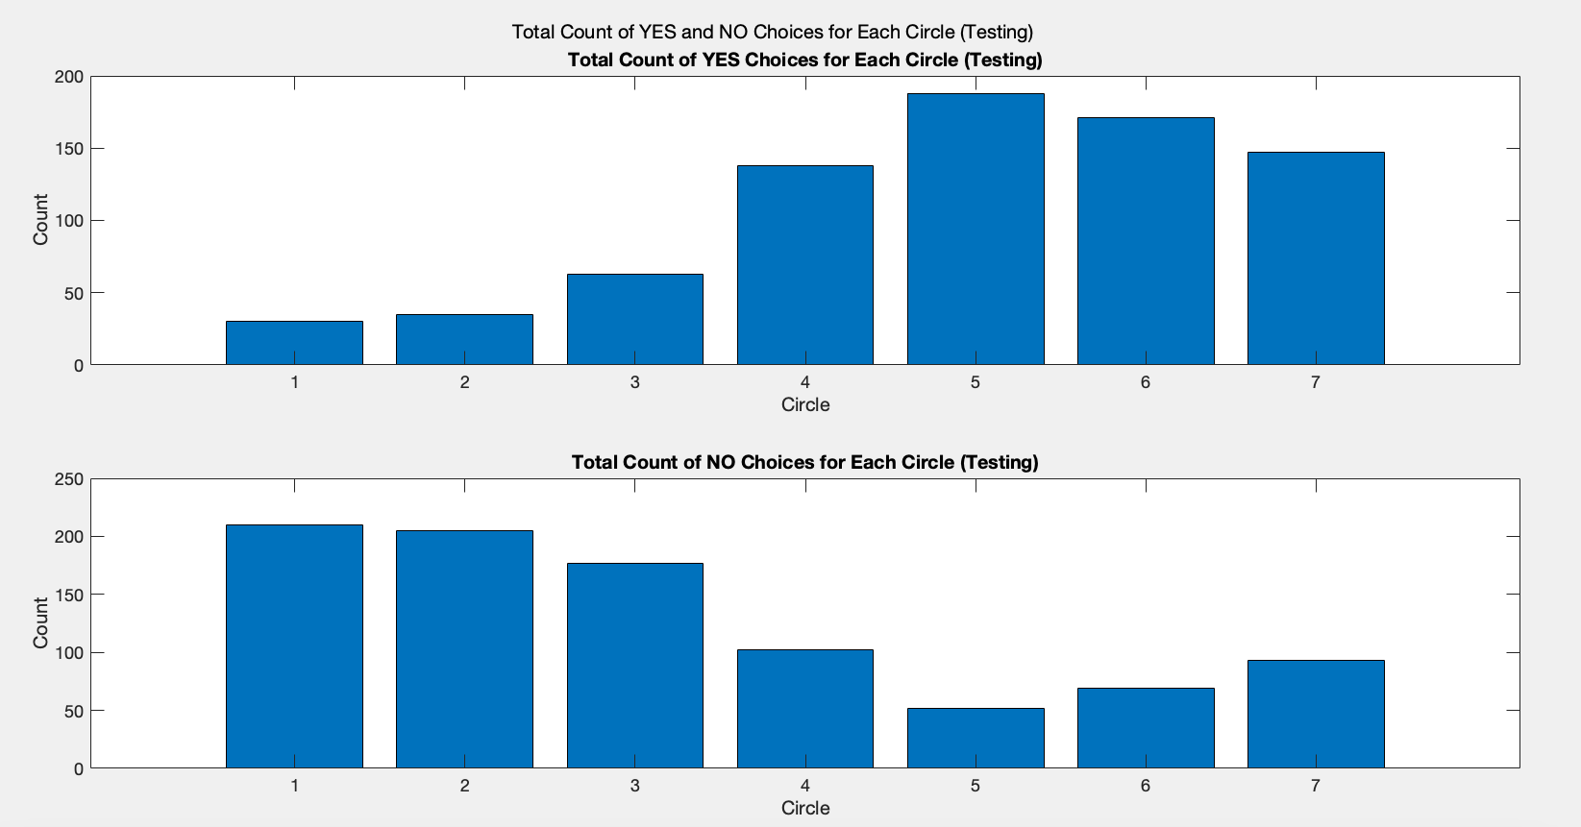

Slide 3
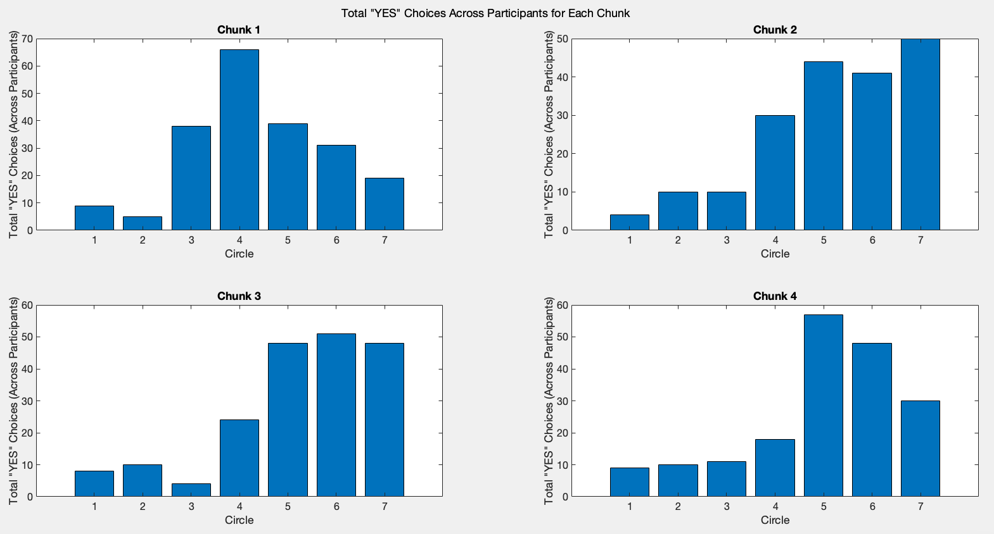
Across participant data – testing session

Slide 4
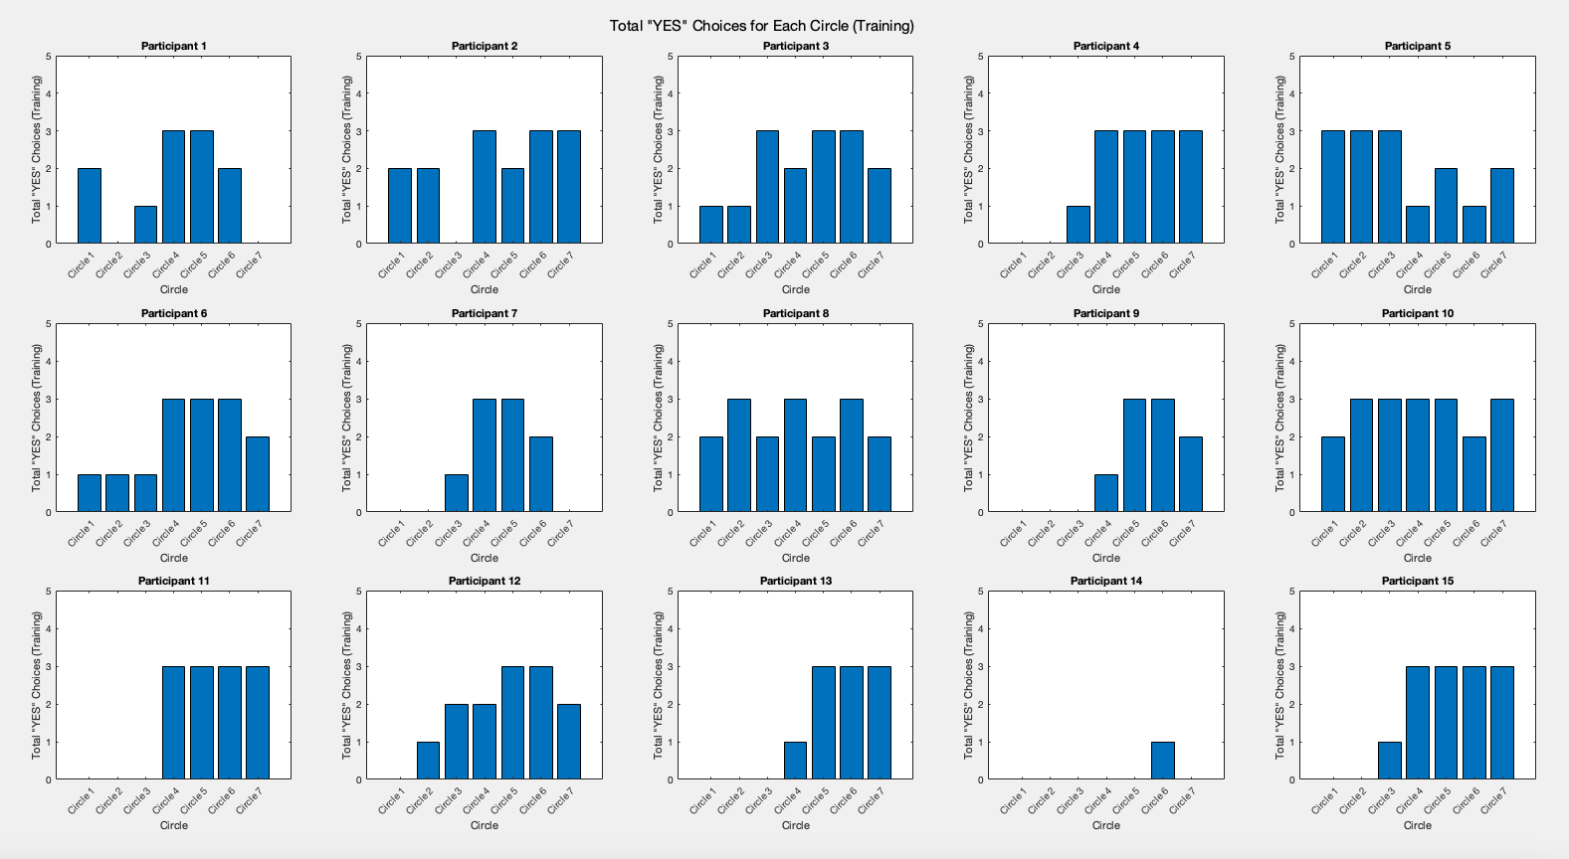
Per participant data – training session

Slide 5
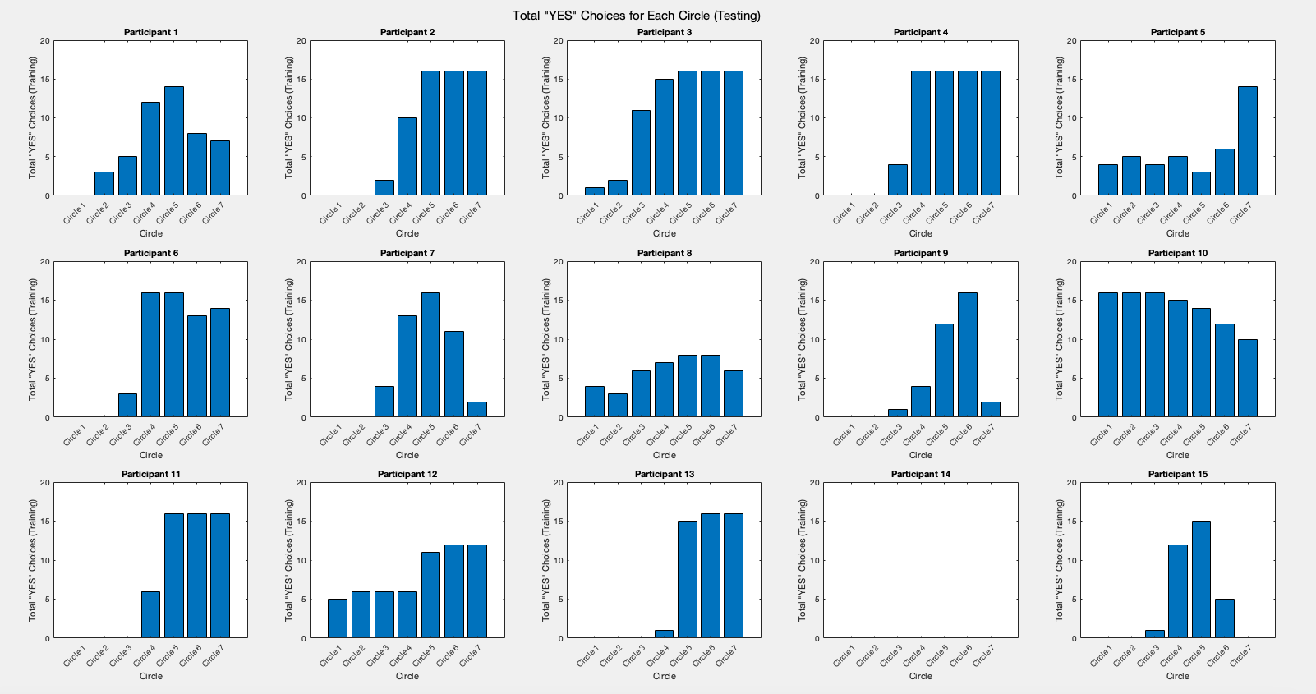
Per participant data – testing session

Slide 6
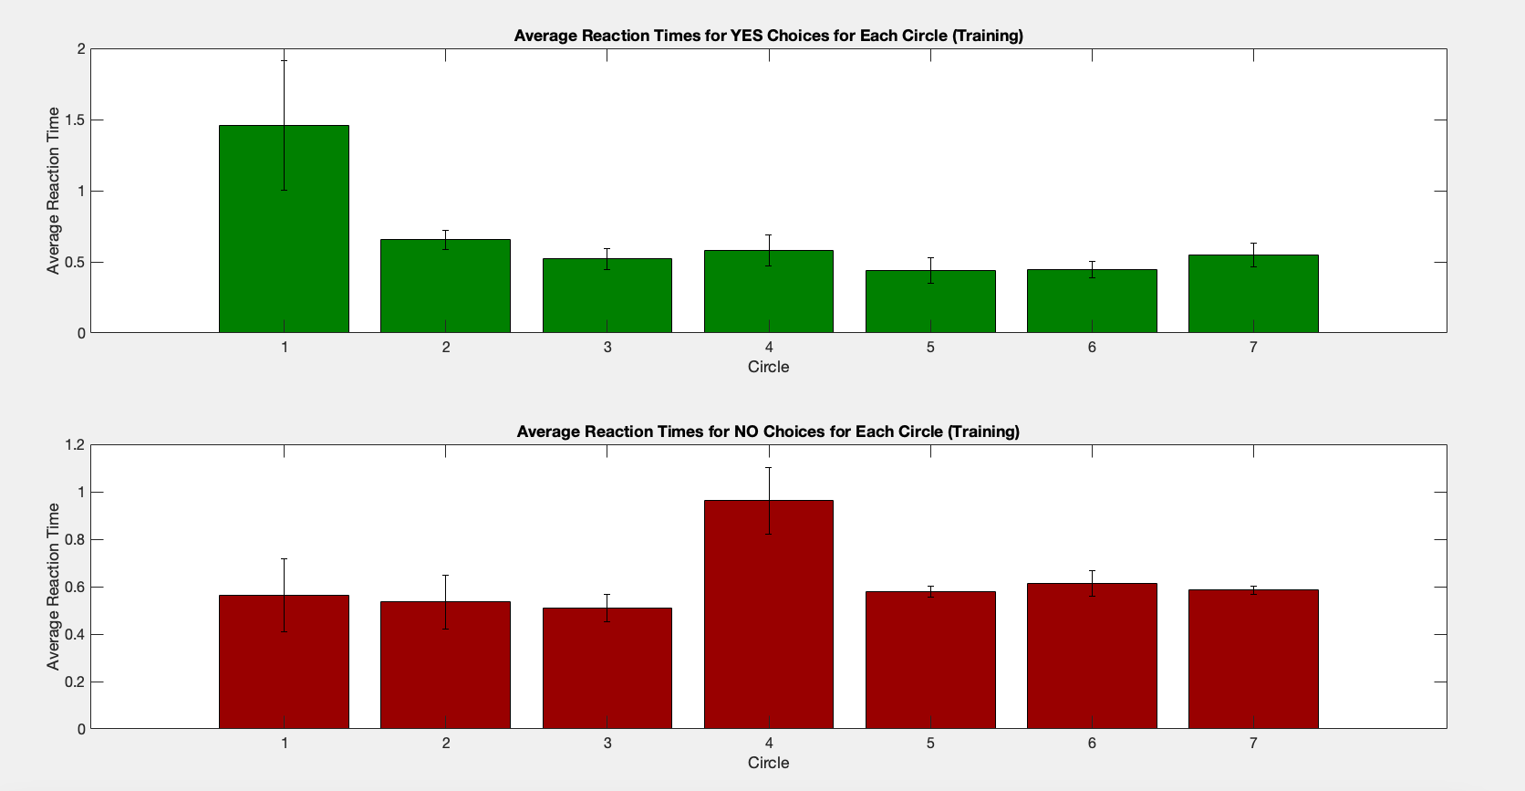
Reaction times – training data, across participants

Slide 7
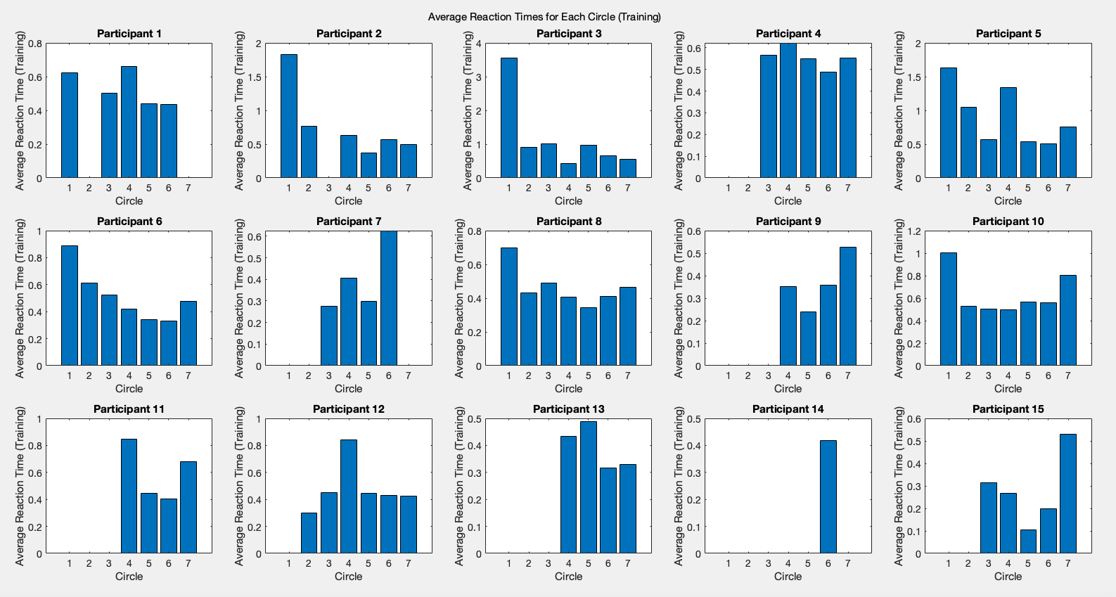
Reaction times – per. participant, training data

Slide 8
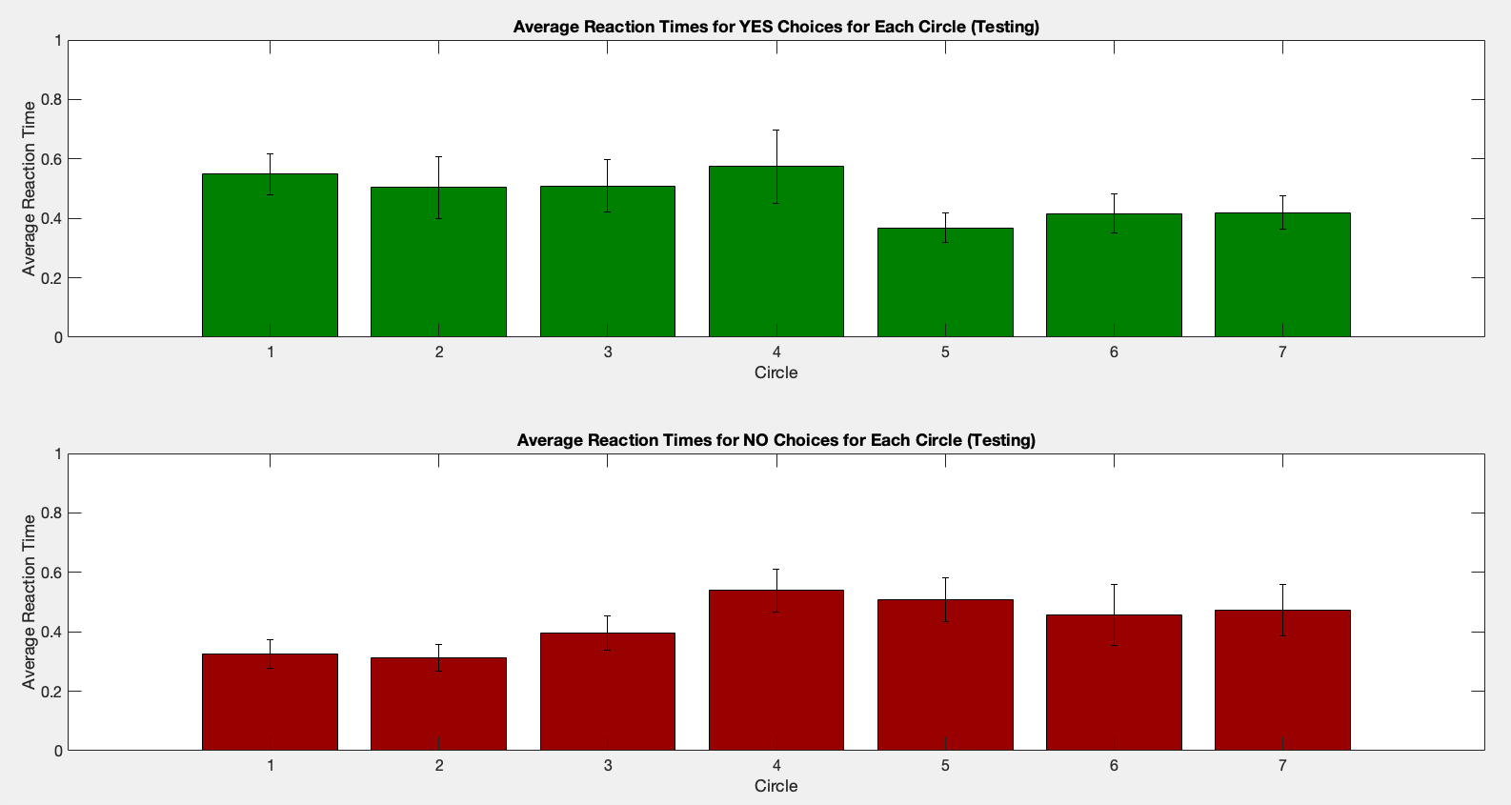
Reaction times – per. participant, testing data

Slide 9
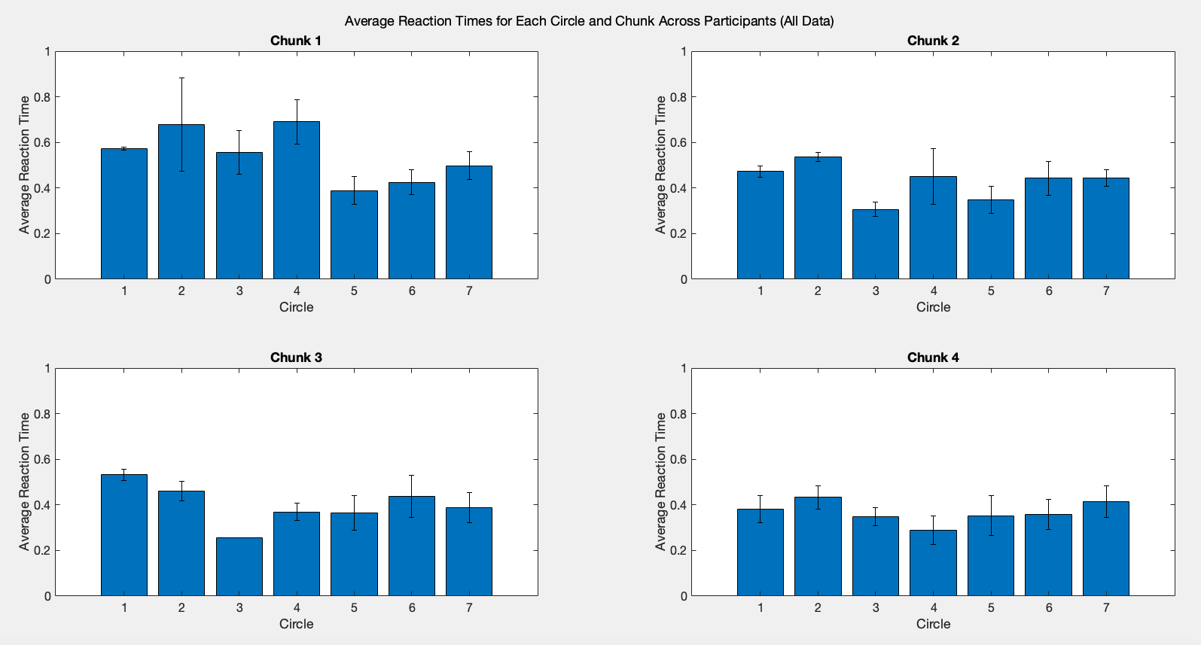
Reaction times – per. chunk, across part., testing data

Slide 10
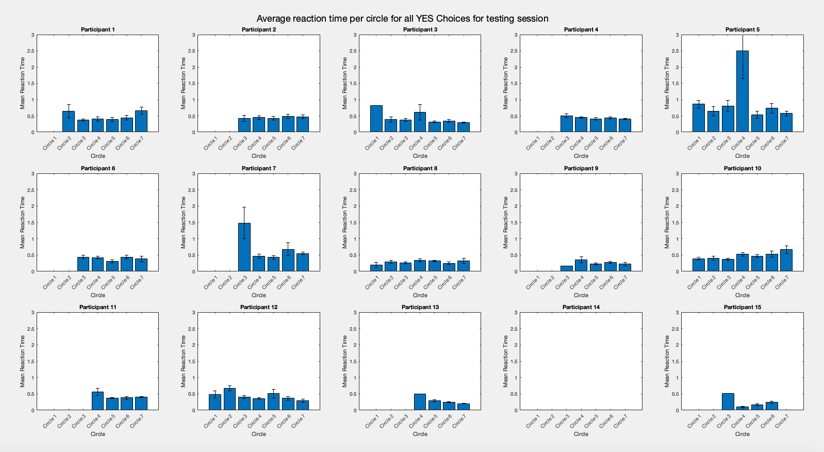
Reaction times – per. part., testing data

